Slide 1
Introduction to Touchpoint Curriculum
TC
1
Version 2.0
(Updated April 2023)

Slide 2
Agenda
What Are Touchpoints?
Why Do We Have Touchpoints?
Navy-specific Requirements
Training Completion Options
Touchpoint Examples
Resources

Slide 3
What Are Touchpoints?

Slide 4
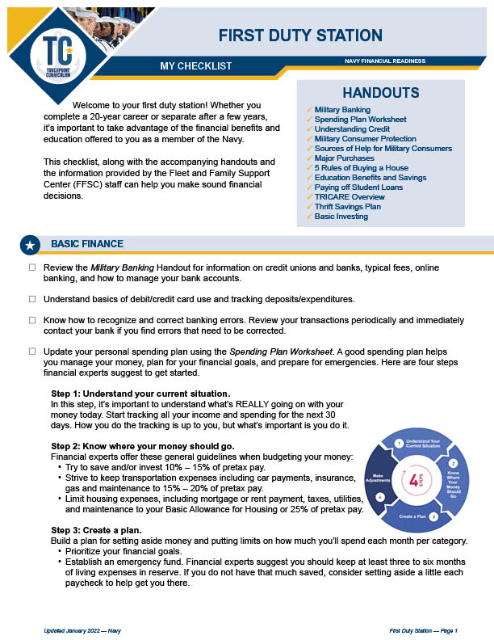
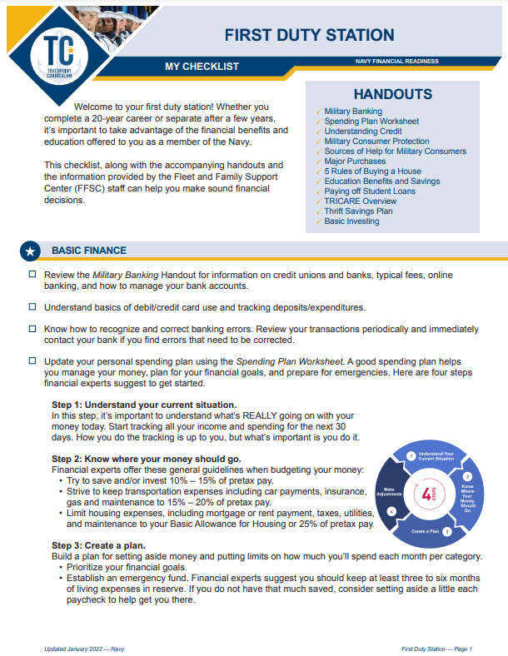
Touchpoints Defined
Each phase of a military career comes with new milestones and important financial considerations. We call these life milestones “Touchpoints.”
The DoD & DoN developed quick informational videos, checklists, and resources to help navigate through these important “Touchpoints.”

Slide 5
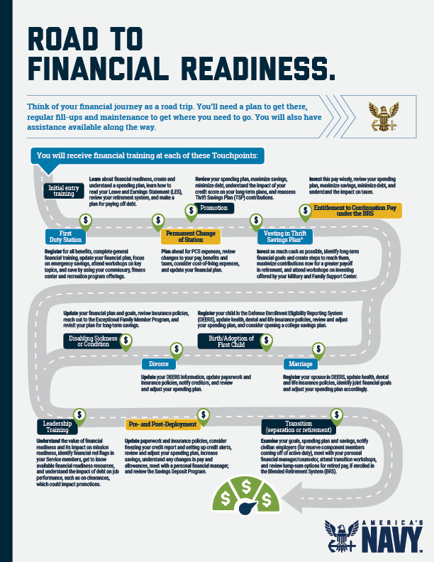
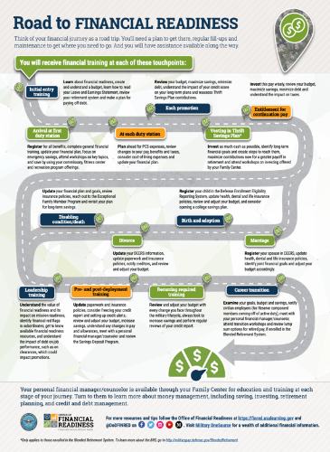
Road to Financial Readiness
Initial Entry Training
First Duty Station
PCS Moves
Promotion
Vesting in the TSP
Entitlement for Continuation Pay
Disabling Condition
Divorce
Birth/Adoption of First Child
Marriage
Leadership Training
Pre- and Post- Deployment
Transition

Slide 6
Why Do We Have Touchpoints?

Slide 7
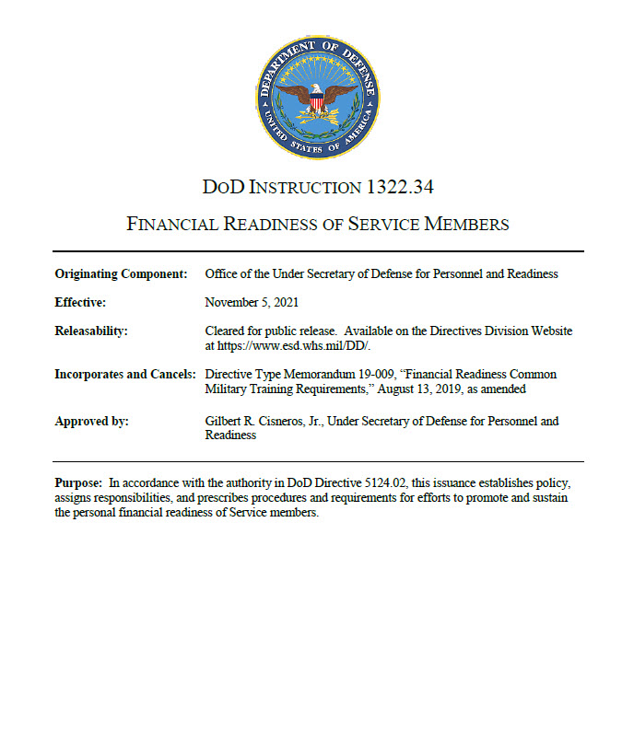
Required DoD Training
DODI 1322.34
Financial Readiness of Service Members
It’s law: Section 992 of Title 10, U.S.C.
The Military Departments will provide programs and resources addressing the financial decisions facing Service members, and the effects such decisions can have on their personal and professional lives.

Slide 8
Navy-specific Requirements

Slide 9
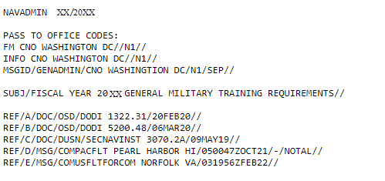
Navy Regulations
Yearly General Military NAVADMIN
Mandatory at personal and professional Touchpoints across the military life cycle
Virtual courses are available via:
  Navy e-Learning
  MyNavy Financial Literacy mobile app
In-person training can be provided by:
  FFSC PFM
  Command Financial Specialist
  Navy Reserve Center-assigned PFC

Slide 10
Navy Touchpoint Process
NSIPS Message directs Sailor to a CFS or FFSC for assistance as well as self-paced options.
  An administrative action triggers the NSIPS notification after the event happens (received orders, updated DEERS, etc.)
  Sailors must keep email updated in NSIPS. This is also how they will receive notification to apply for Continuation Pay.
The Sailor can contact a CFS or PFM to schedule Touchpoint training or the Sailor opts to complete virtual self-paced options.
Sailor provides verification of completed training to command training department for FLTMPS entry.

Slide 11
Training Completion Options

Slide 12
Training Delivery Methods
In-Person
One-on-One
  Checklist and handouts
Classroom
  Checklists and handouts
  PowerPoint (PPT) Training Slides and Instructor Guide (IG)
  Videos and Video Discussion Guides (VDG)
Virtual
Navy e-Learning
MyNavy Financial Literacy App

Slide 13
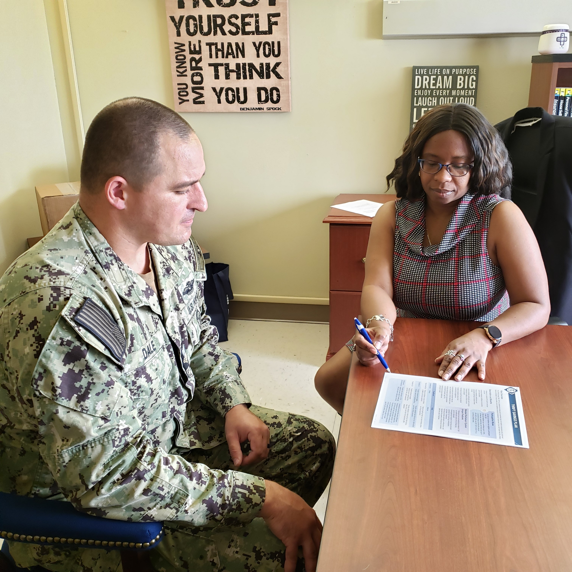
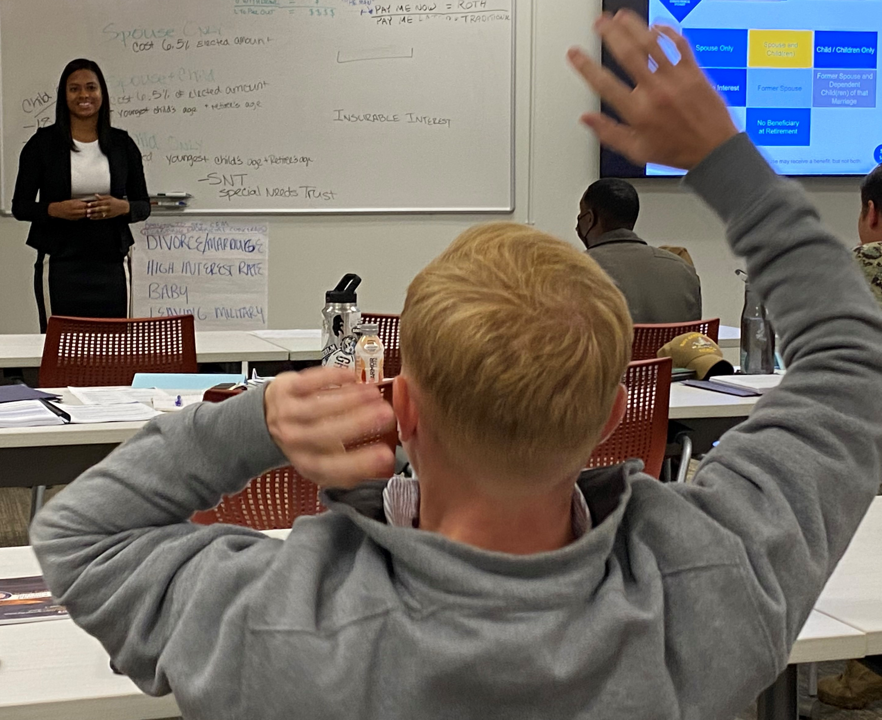
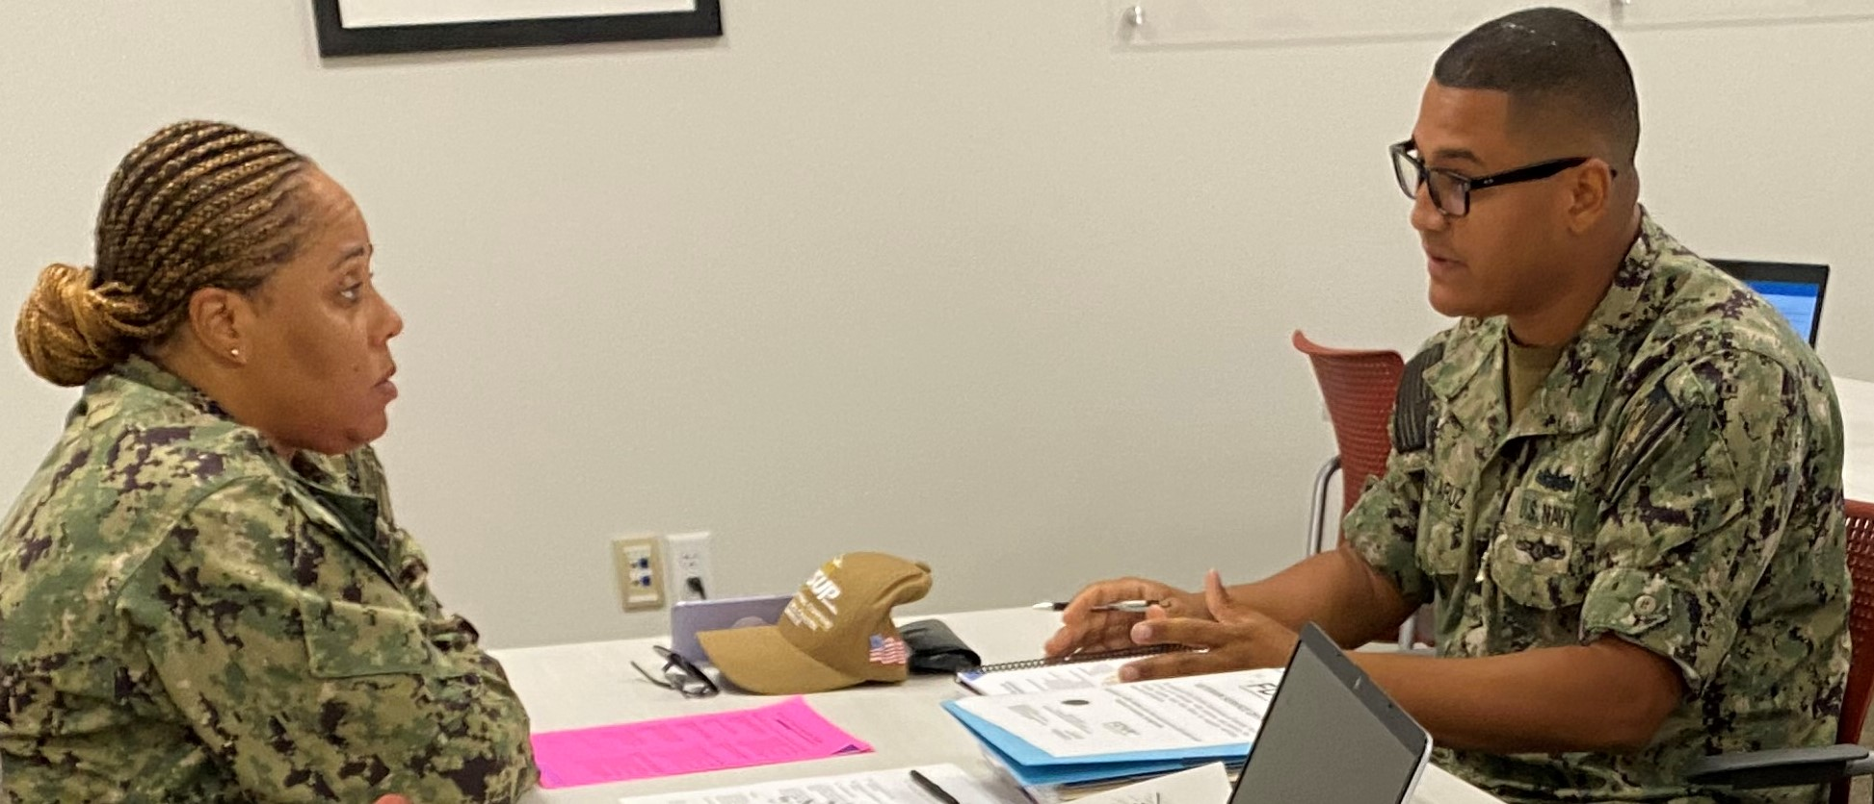
In-person Training
One-on-One
Classroom
FFSC Personal Financial Manager
Command Financial Specialist
Personal
Financial Counselor

Slide 14
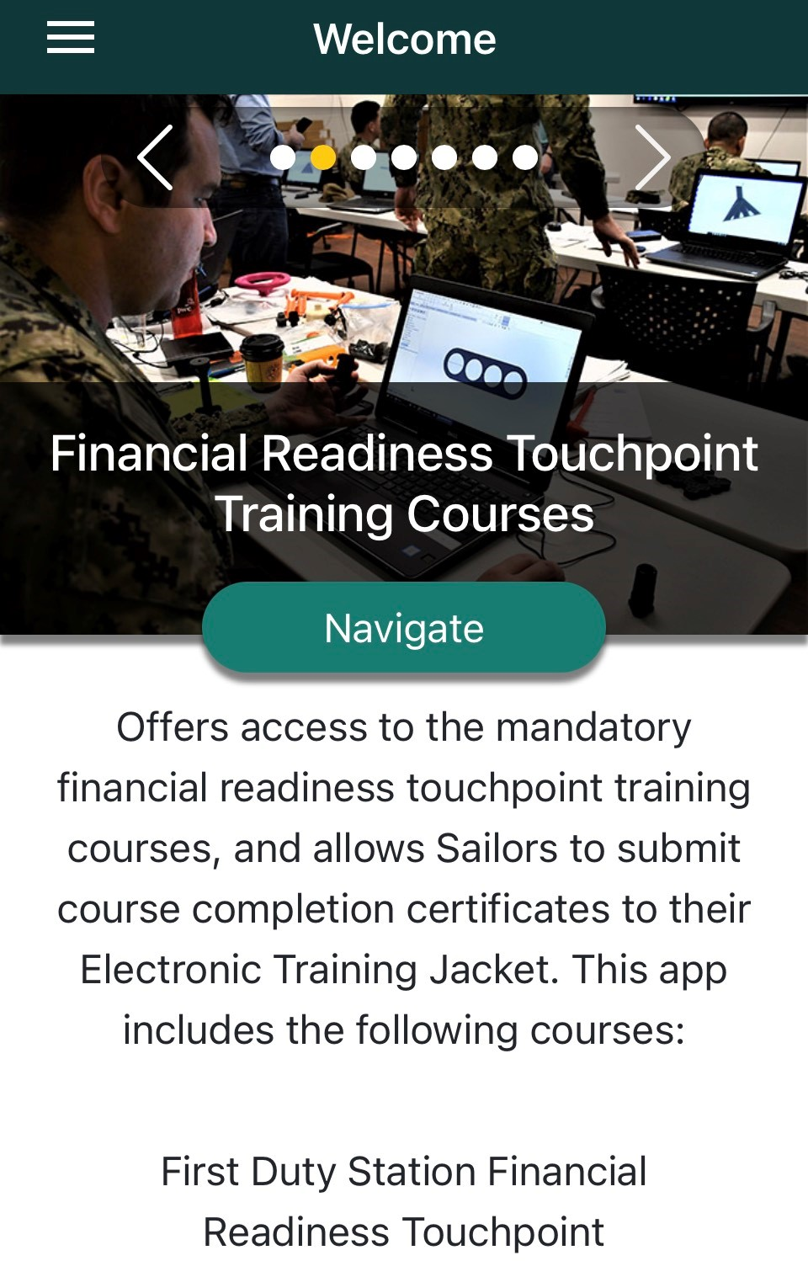
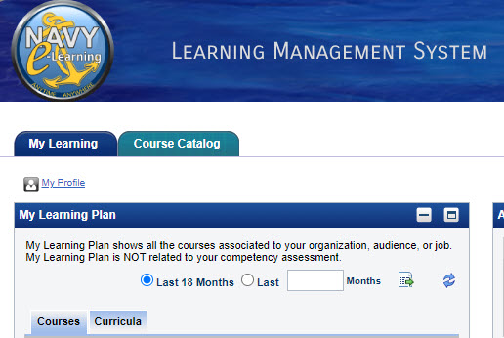
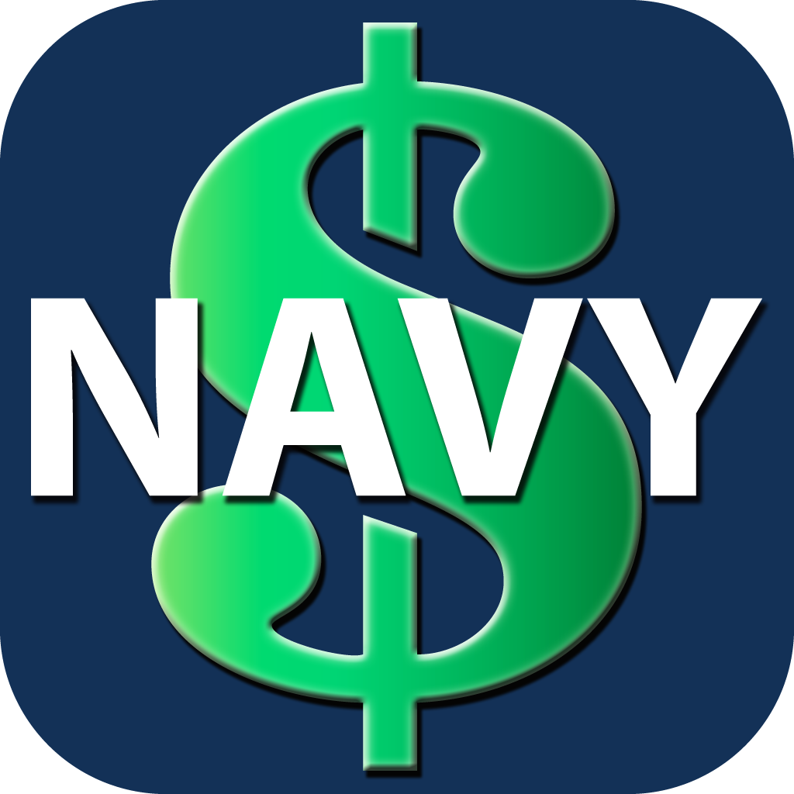
Virtual Training
MyNavy Financial
Literacy Mobile App
Navy e-Learning LMS

Slide 15
Touchpoint Examples

Slide 16
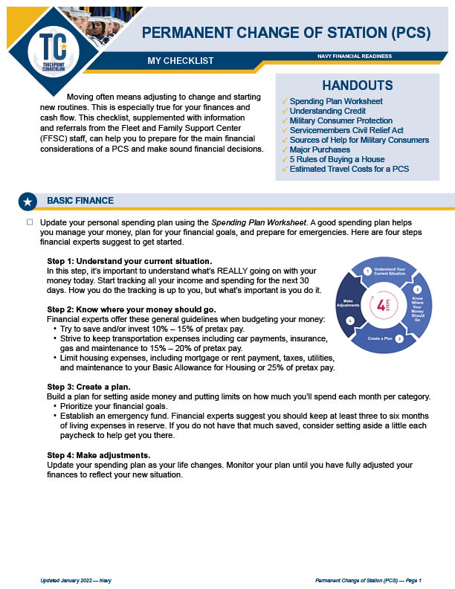
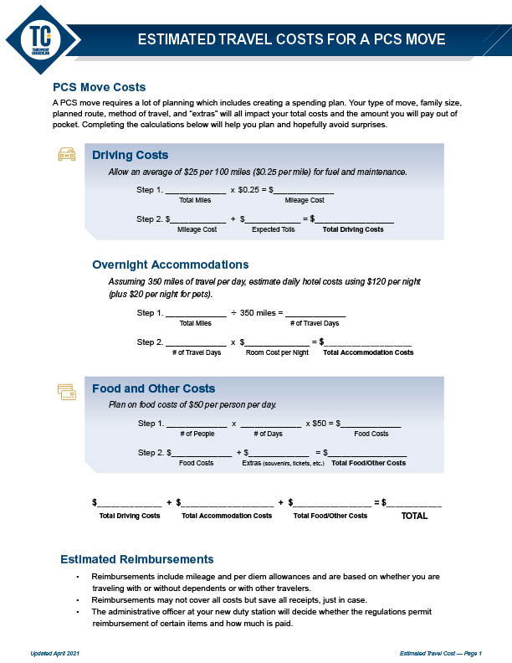
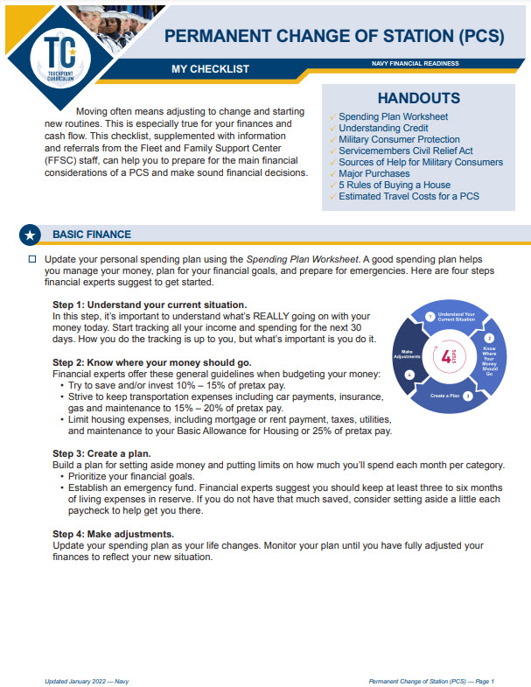
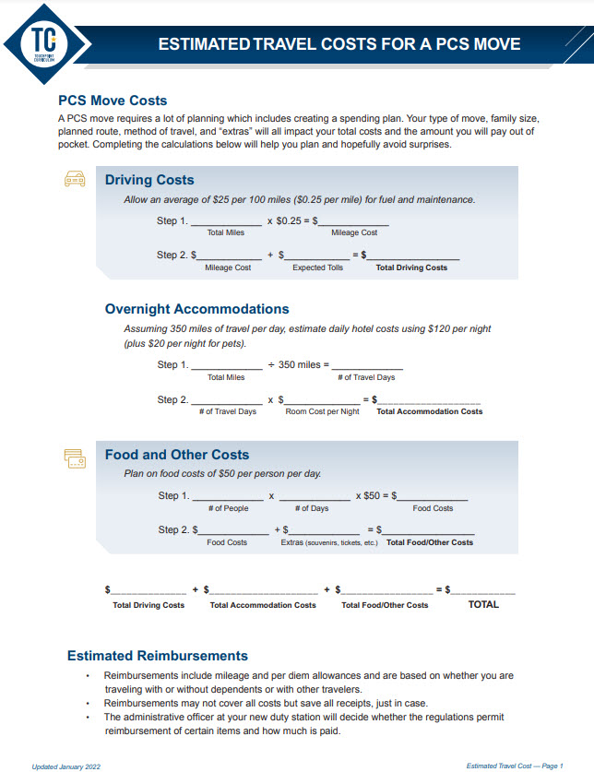
Checklists and Handouts

Slide 17


Slides and Instructor Guide

Slide 18
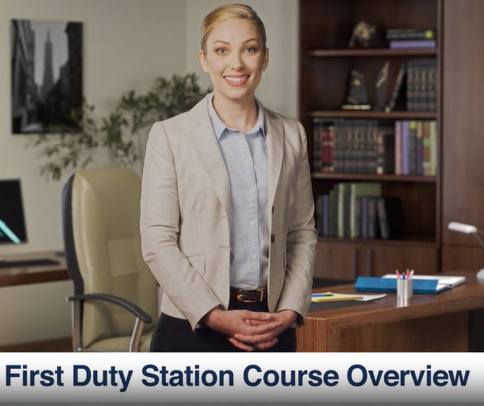
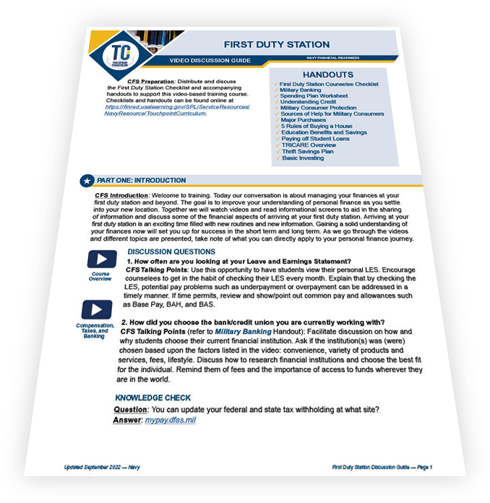
Video Discussion Guide

Slide 19
Resources

Slide 20


Resources
Checklists and Handouts
Financial Education and Support
  Command Financial Specialists (CFSs)
  Personal Financial Managers (PFMs)
  Installation Fleet and Family Support Center (FFSC)
  Relief Societies
  Military OneSource
Financial Literacy Mobile Apps
  MyNavy Financial Literacy
  Sen$e

Slide 21
Questions?
The appearance of U.S. Department of Defense (DoD) visual information does not imply or constitute DoD endorsement.
(Updated April 2023)

